Slide 1
TOUCH TYPING APP
MET CS665 12/5/23 By: Jacob Kustra

Slide 2
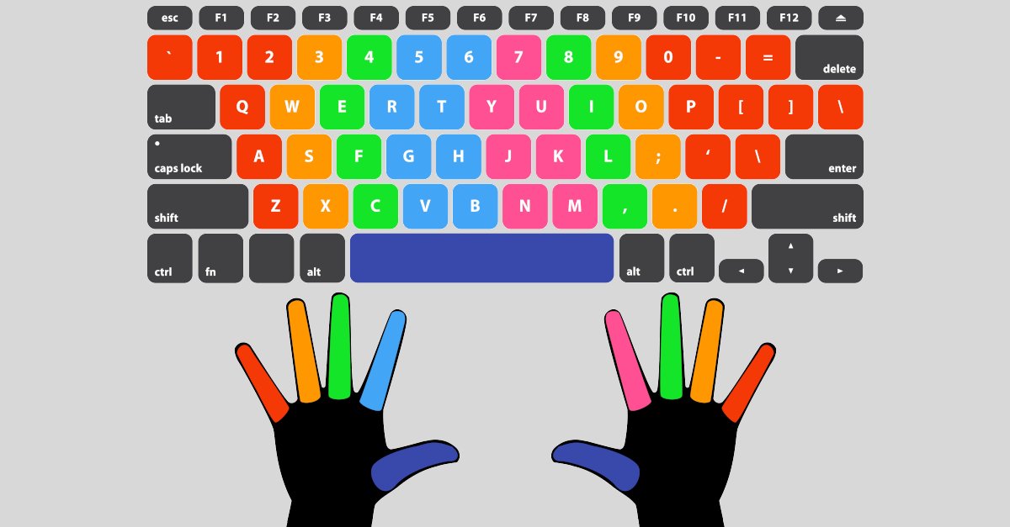
WHAT IS TOUCH TYPING?
Typing with all 10 fingers

Slide 3
WHY DOES THIS MATTER
- According to typing.com, the average hunt and peck method user (using only pointer fingers and thumbs), can type an average of 27-37 words per minute.
- Also, according to the same website, the average user typing using the touch typing method is between 40-60 word per minute.
- Faster typing speed = more code output, which must equal better software engineer right?
- Application’s Goal: Create a way I could use to improve my typing speed.
Source: Link

Slide 4
DESIGN PATTERN CHOSEN
Separated Interface
Design Pattern
- Separates the definition of the interface and its implementation into distinct packages making it a structural design pattern.
- This approach ensures that the client remains does not know how the implementation is done.

Slide 5
PROBLEM IT SOLVES
FUTURE-PROOFING THE IMPLEMENTATION WITH WHAT THE CLIENT SEES ON THEIR END.
The client will not see/be impacted by changes within the code’s implementation.
PROMOTES WEAK COUPLING IN THE CODE
Allows for multiple teams to word on the code without ”stepping on each other’s toes.”
ALLOWS FOR THE CODE TO BE MORE MODULAR
With multiple clients, they all may request that the implementation works a bit differently and this design patterns allows for that to happen all in the same application.

Slide 6
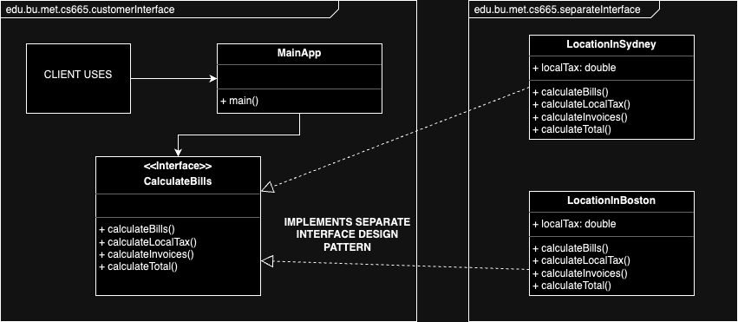
BASIC UML DIAGRAM

Slide 7
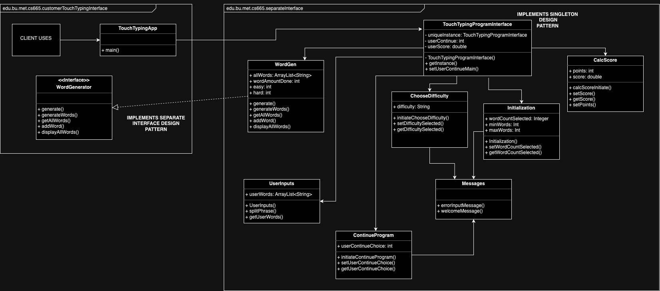
PROJECT UML DIAGRAM

Slide 8
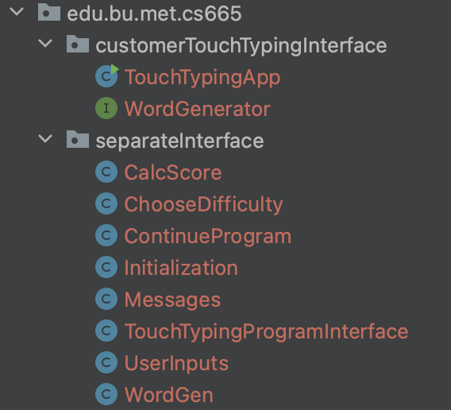
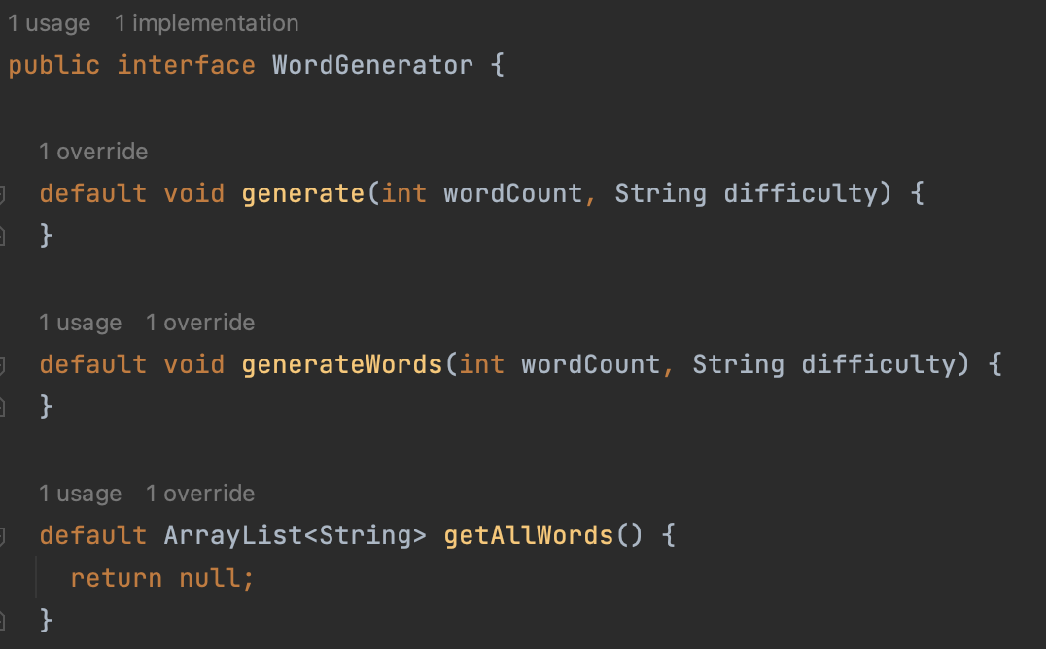
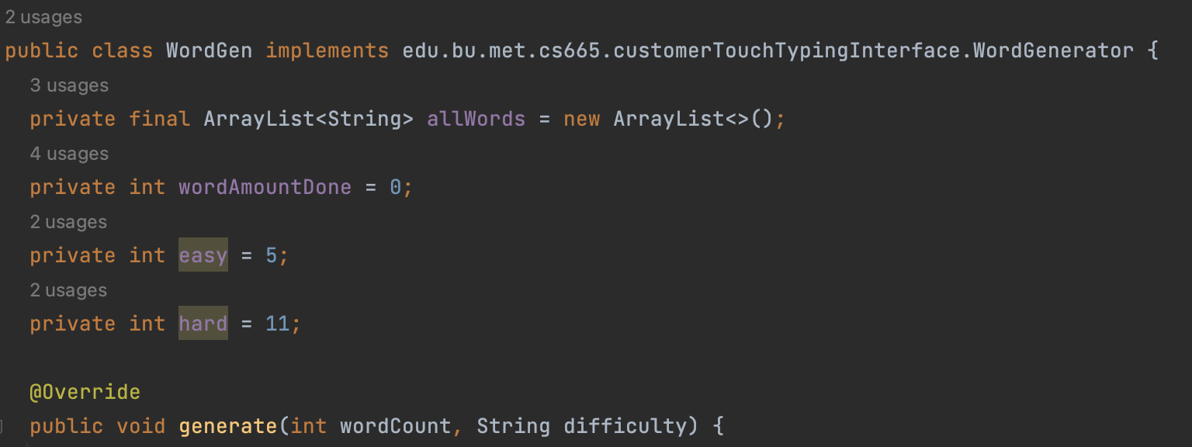
CODE SCREENSHOTS
SEPARATE INTERFACE
DESIGN PATTERN.

Slide 9
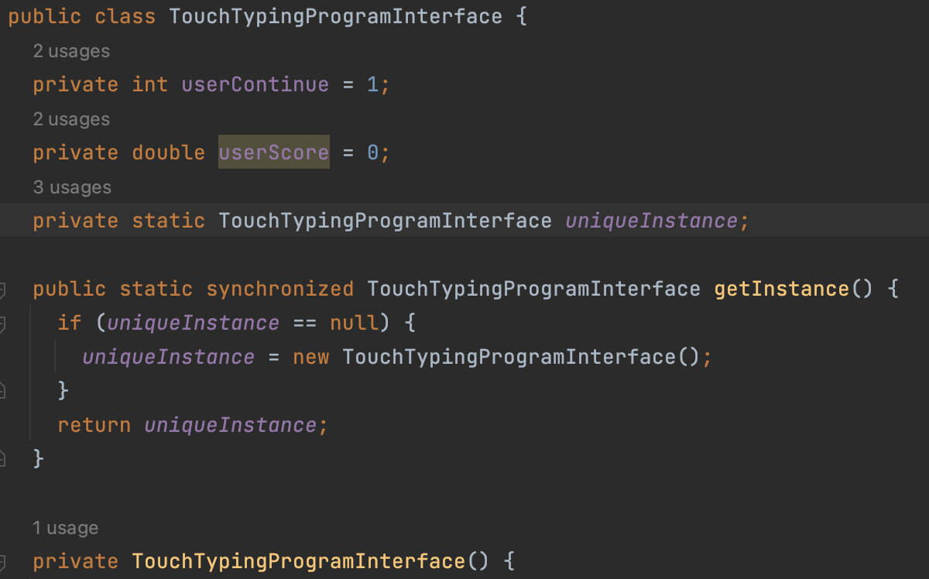
CODE SCREENSHOTS CONT.
SINGLETON DESIGN PATTERN.

Slide 10
CONCLUSIONS ABOUT THE SEPARATE INTERFACE DESIGN PATTERN
- | Relatively simple to implement.
- | Easily adaptable to any project.
- | Increases overall application security
- | Decreases coupling further and allows for easier changes in the future code with less impact on the customer.

Slide 11
CODE DEMO

Slide 12
THANK YOU ANY QUESTIONS?

